Slide 1

pharminder
Find your medicine

Slide 2
proposal
Our service is developed for everyone who is searching for a specific medicine in an area near to them.
The user is able to access a set of different pharmacies in order to find their needed medicine and discover the nearest pharmacy to them.
It will be developed to run on web browsers and Android devices.

Slide 3
The project interfaces
Search page
Admin login
Admin forms
Medicine form
Pharmacies form
Pharmacy owners
Search result

Slide 4

Search page

Slide 5
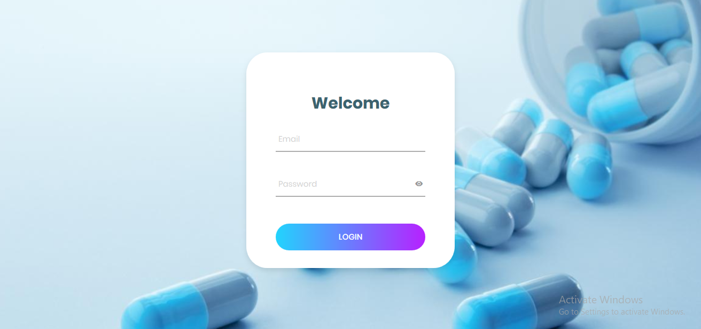
Admin login

Slide 6

Admin forms

Slide 7
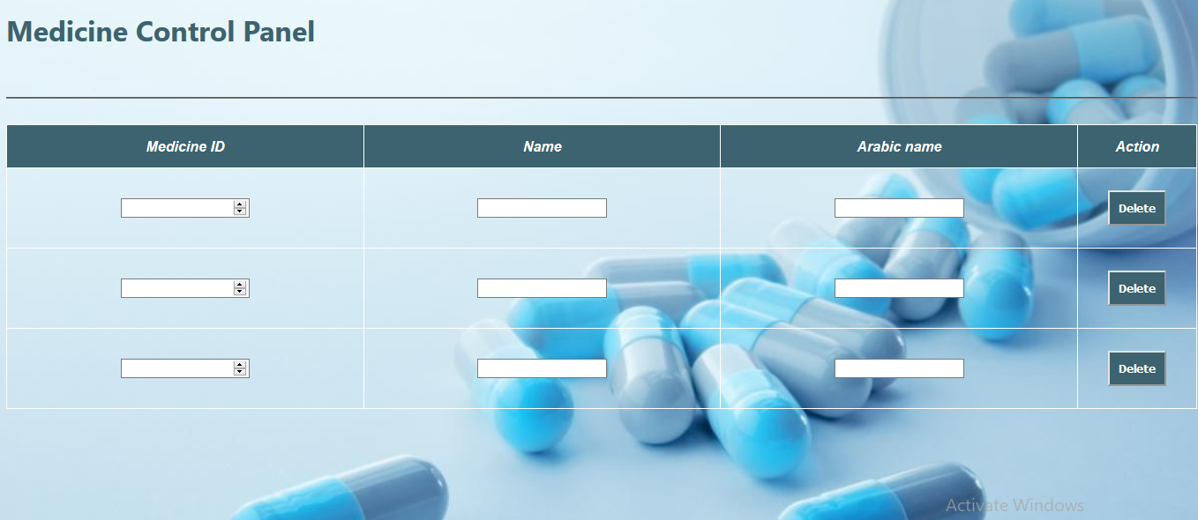
Medicine forms

Slide 8
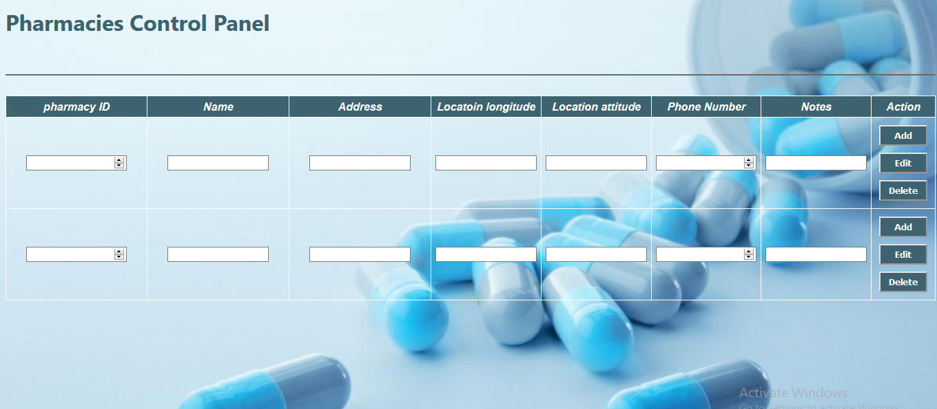
Pharmacies form

Slide 9
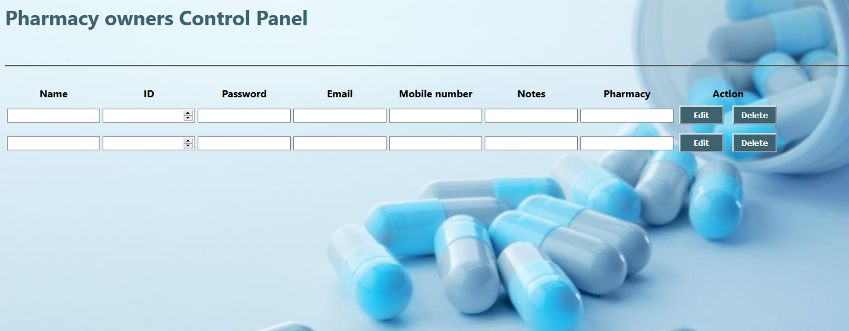
Pharmacy owners

Slide 10
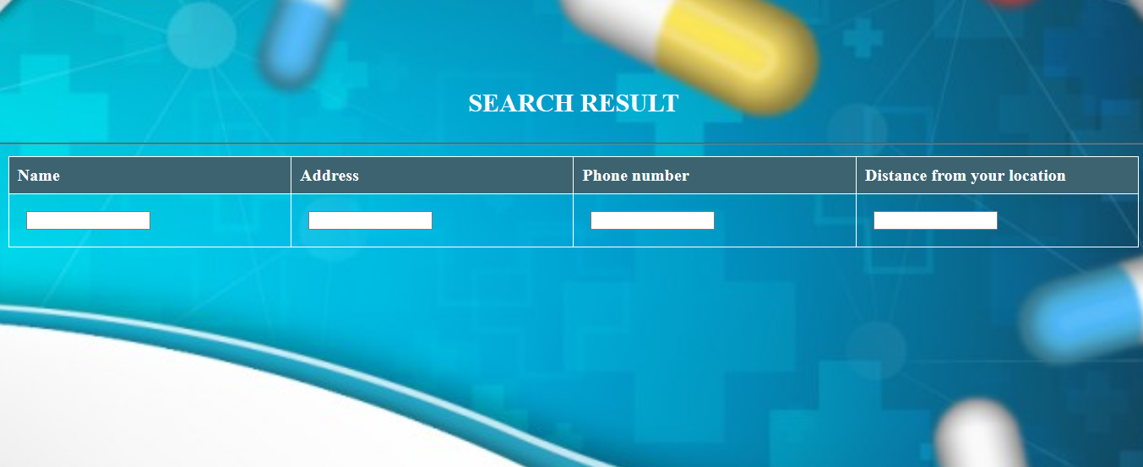
Search result

Slide 11
Project team members
Mostafa Elshazly
Nada kamal
Yomna sabry
Asmaa khamess

